Slide 1
Federated & Centralized Models
Tuesday, October 30, 2012
Facilitator: Jim Campbell (SST), Jeff Sellers (SST), Keith Brown (SST)
Panelists:
Charles McGrew, Kentucky P-20 Data Collaborative
Mimmo Parisi, National Strategic Planning & Analysis Research Center (nSPARC)
Neal Gibson, Arkansas Research Center
Aaron Schroeder, Virginia Tech

Slide 2
Agenda
- Background/Overview
Rationale for choosing a model
Infrastructure and design
Data Access
Additional information

Slide 3
Background/Overview

Slide 4
Kentucky
Model:
Centralized data warehouse that brings the data into a neutral location (third-party) where they are linked together then de-identified so no agency has access to any other agency’s identifiable data.

Slide 5
Virginia
Model:
Virginia is a case study in the difficulties of combining data from multiple agencies while remaining in compliance with federal and state-level privacy requirements
Traditional Data Integration Issues
Public Sector Specific Integration Issues
Virginia Specific Issues

Slide 6

Virginia
Implementation Environment Public Sector Statutory and Regulatory Heterogeneity
Multiple levels of statutory law
Multiple implementations of regulatory law at each level of statutory law
Most conservative interpretation of regulatory law becomes de facto standard

Slide 7

Arkansas
Arkansas Research Center

Slide 8

Arkansas

Slide 9
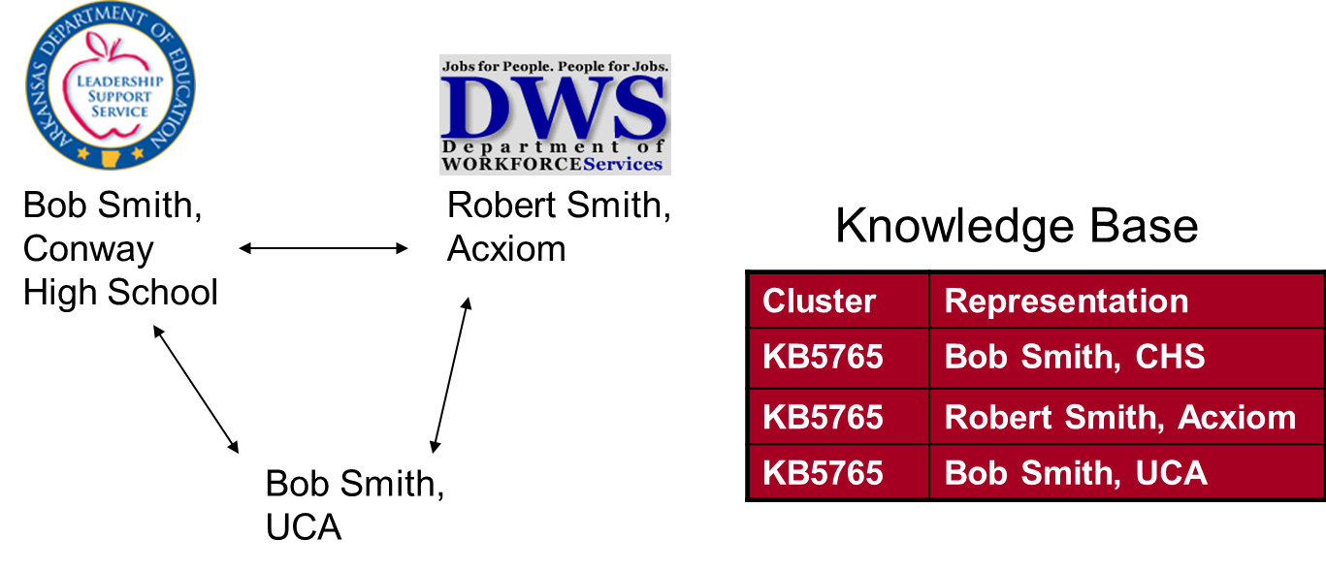
Arkansas
Knowledge Base Approach:
All known representations are stored to facilitate matching in the future and possibly resolve past matching errors.

Slide 10

Mississippi
STATEWIDE LONGITUDINAL DATA SYSTEM (SLDS)

Slide 11
Mississippi
CULTURE OF COOPERATION
STRUCTURAL & TECHNICAL CAPACITY
PERFORMANCE-BASED MANAGEMENT

Slide 12
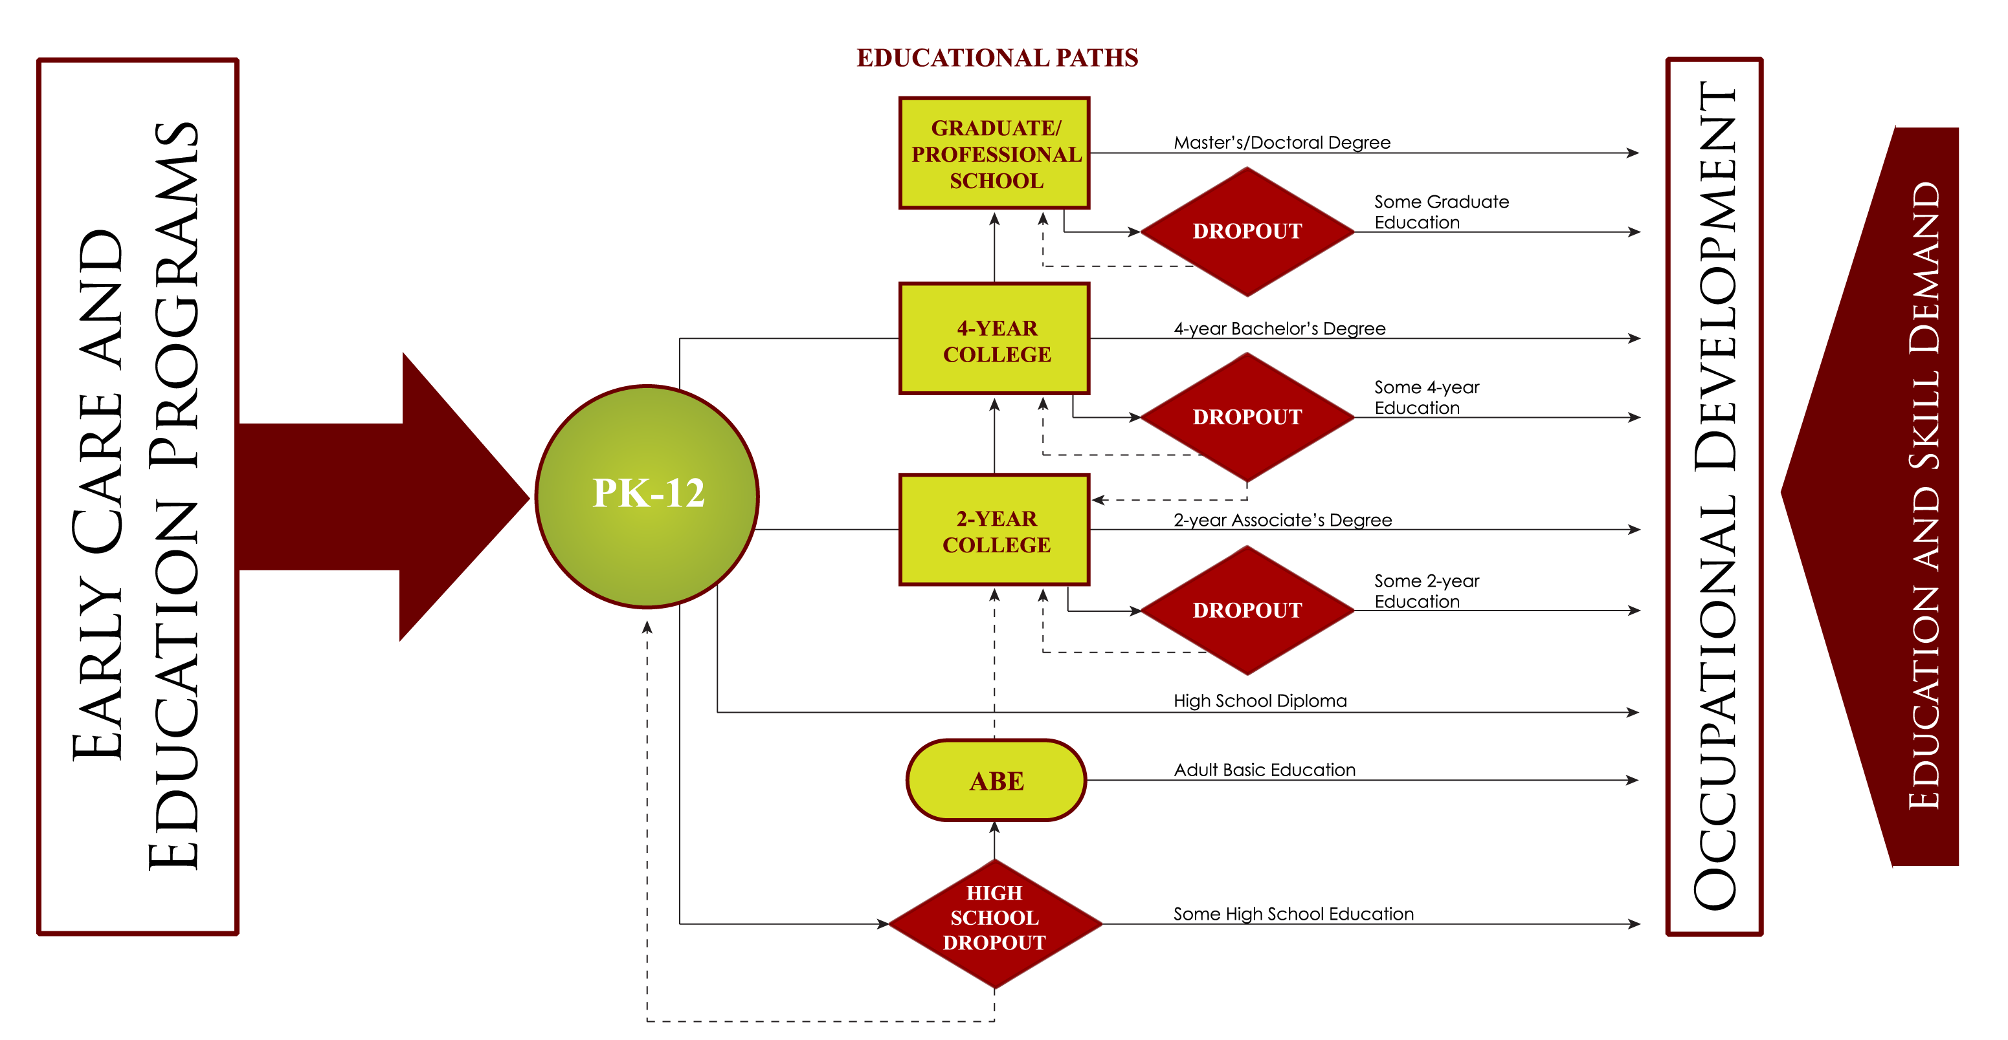
Mississippi
SLDS CONCEPTUAL MODEL

Slide 13
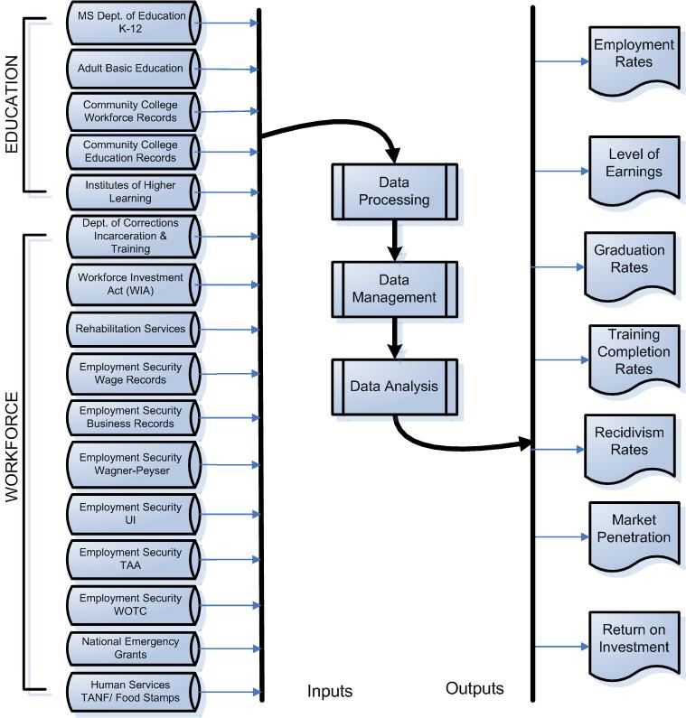
Mississippi
DATA WAREHOUSE MODEL

Slide 14
Rationale for Choosing a Model

Slide 15
Kentucky
Not all agencies we want to participate have data warehouses and could participate in a federated model.
Upgrades and infrastructure changes in participating agencies would interrupt “service”.
Political concerns about changing leadership that may allow agencies to simply stop participating.
Centralizing data allows for shared resources and cost savings over more “silo” data systems.
Most agencies lack research staff to utilize the system and there was a desire to centralize some analyses.
The de-identified model satisfies agency legal concerns.
The ability to reproduce numbers over time.

Slide 16
Virginia
Implementation Environment and Virginia Specific Limitations:
Structural
Decentralized authority structure in potential partner agencies (e.g. health, social services) resulting in different data systems, standards, and data collected
Legal
VA § 2.2-3800: Government Data Collection and Dissemination Practices Act
VA § 59.1-443.2 - Restricted use of social security numbers
Assistant Attorneys General interpretations
“No one person , inside or outside a government agency, should be able to create a set of identified linked data records between partner agencies”

Slide 17
Virginia
Consolidated Data Systems (Warehouse)
Can be very expensive (to both build and maintain)
Too difficult to embody (program) the multiple levels of federal and state statutory and regulatory privacy requirements – must have laws in place to allow for centralized collection
Lack of clear data authority, per data system, between state agencies and between state and local-level agencies – participation is not compulsory
Federated Data Systems
System that interacts with multiple data sources on the back-end and presents itself as a single data source on the front-end
The key to linking up the different data sources is a central linking apparatus
Allows for the maintenance of existing privacy protection rules and regulations
Can significantly reduce application development time and cost

Slide 18
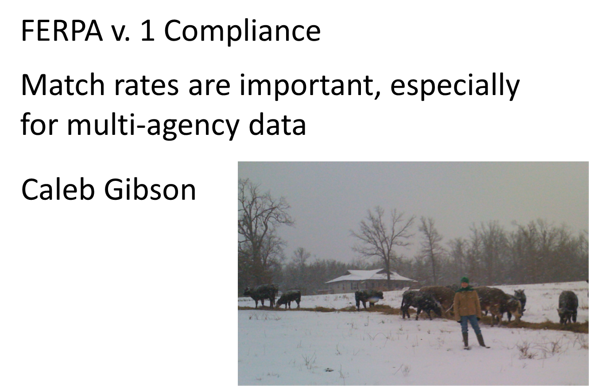
Arkansas

Slide 19
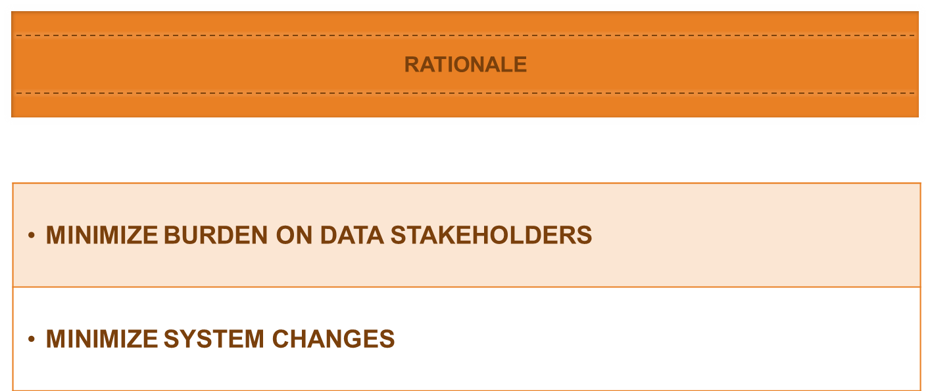
Mississippi

Slide 20
Infrastructure and Design

Slide 21
Kentucky
Agencies provide data on a regular schedule and have access to the de-identified system through a standard reporting tool.
“Master Person” record matching process that becomes “better” over time by retaining all the different versions of data for matching.
Staging environment where data are validated and checked.

Slide 22
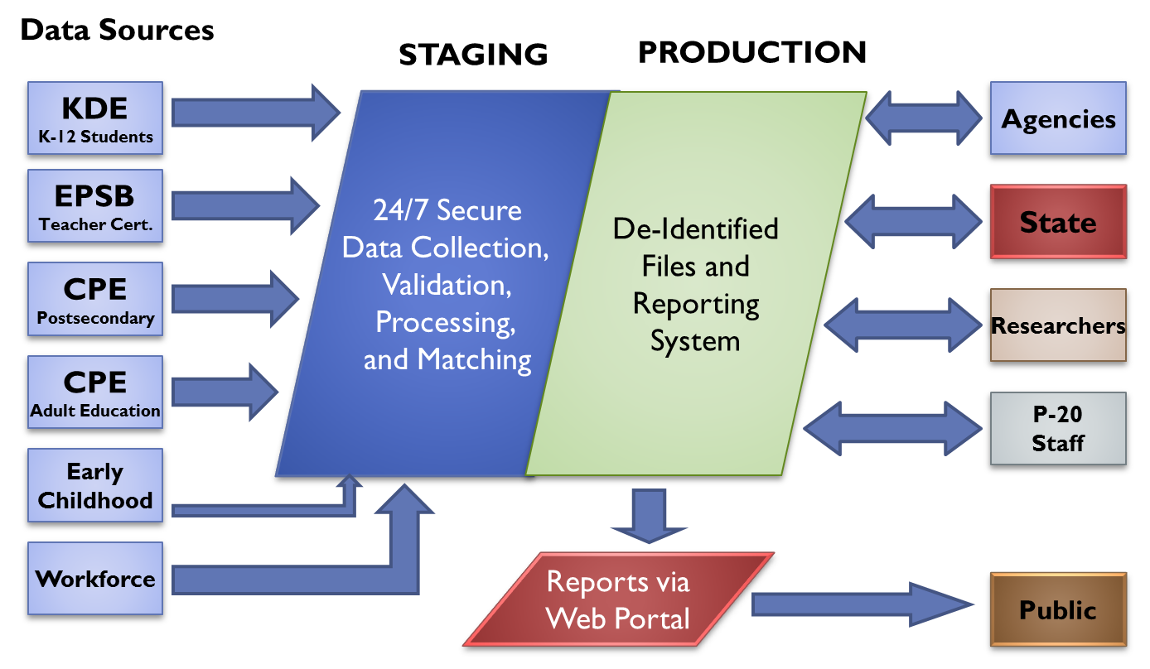
Kentucky

Slide 23
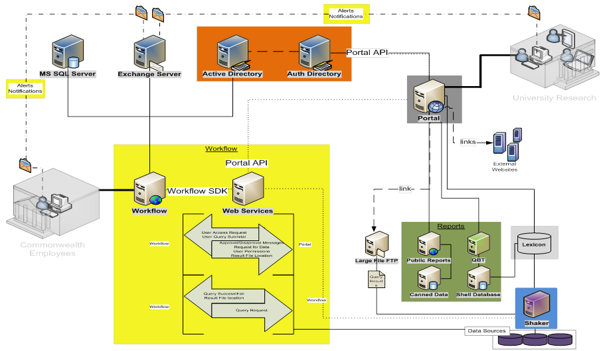
Virginia - Workflow

Slide 24

Lexicon – Shaker Process Overview
User Interface/ Portal/ LogiXML
Common IDs [deterministic] or Common Elements with appropriate Transforms, Matching Algorithms and Thresholds [probabilistic]
Lexicon
Query Building Process
(Pre-Authorization)
Lexicon
?
Field Name | Meta data
A | 10101101010100110110
B | 01010111001010010110
C | 01101010100101010110
Field Name | Meta data
A | 10101101010100110110
B | 01010111001010010110
N | 01101010100101010110
Field Name | Meta data
k | 10101101010100110110
b | 01010111001010010110
n | 01101010100101010110
Workflow Manager
DS 1
Linking Control
A linking engine process will update the Lexicon periodically to allow query building on known available matched data fields. No data is used in this process. Queries are built on the relationships between data fields in the Lexicon.
DS 2
Shaker
Sub-Query Optimization
ID Resolution & Query
Authorized Query
DS 3
Query Results

Slide 25
Privacy Protecting Federated query
Two Steps:
Identity Resolution Process
Query Execution Process

Slide 26
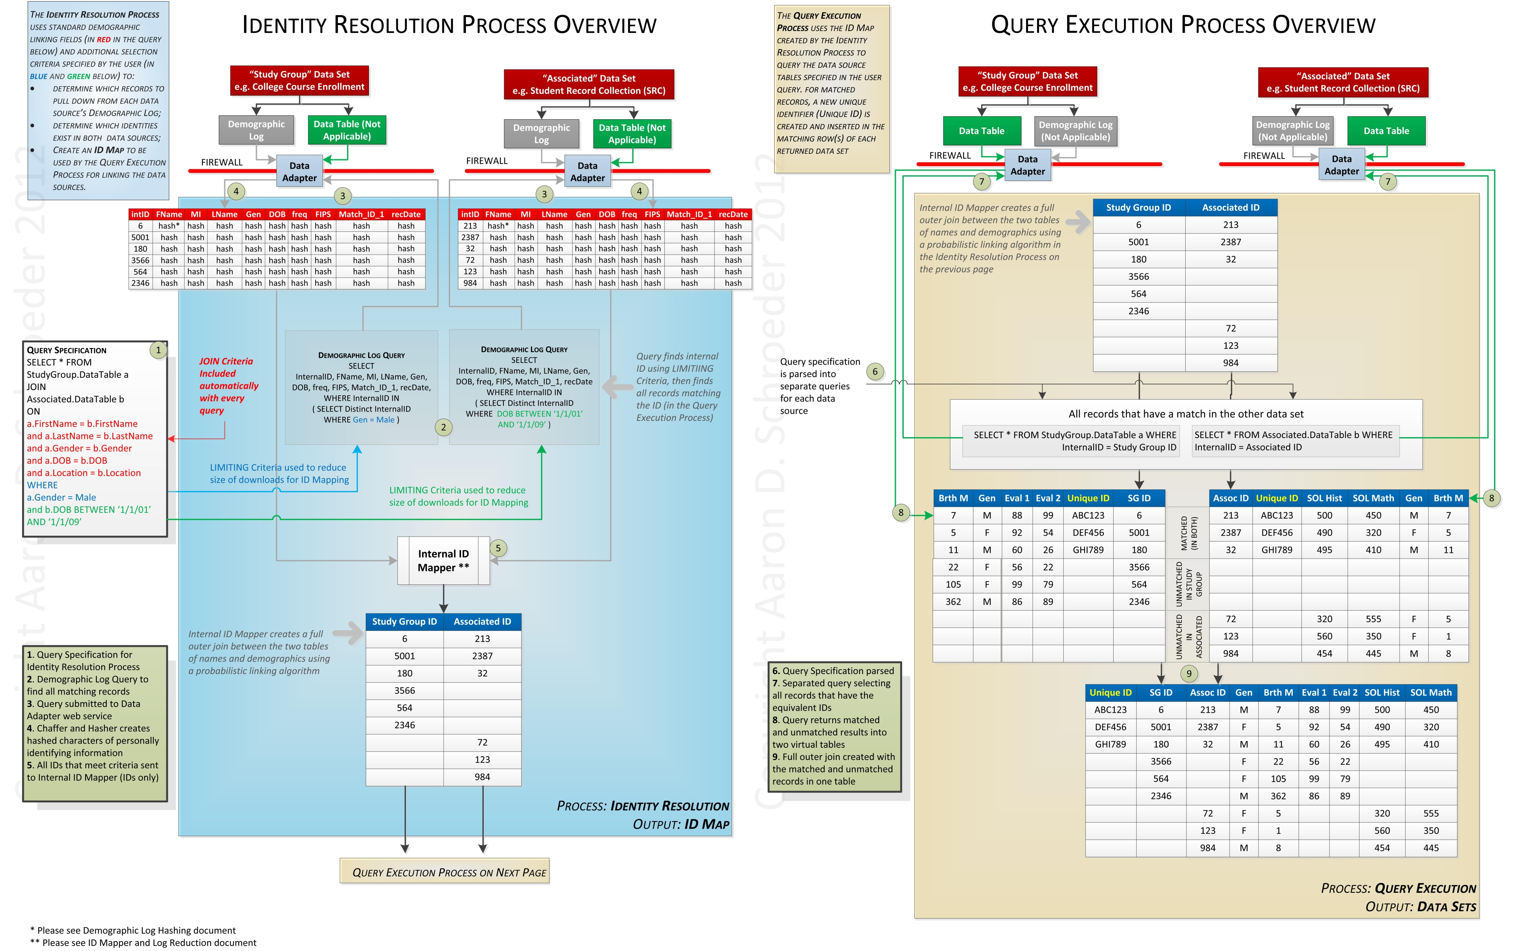

Slide 28
Virginia
How De-Identification Works in VLDS System
Agency 1 Data Source
Agency 2 Data Source
VLDS
DATA
ADAPTER
DATA
ADAPTER
The Data Adapters prepare the data (including de-identification) before leaving the agency firewall.
Agency Firewalls

Slide 29
Getting Data Ready for “De-Identified Federation”
What the Data Adapter Does:
DeSmithBarney
Substitution Alphabet – Dynamically Generated using Hashing Key (below)
De’Smith-Barney IV
De’Smith-Barney IV
YDXWKQTAGOLCNSVEFHMRJPBZUI
Remove Suffix
Substitution Cipher
De’Smith-Barney
CSXBWPAKNOQSH
De’Smith-Barney
Hashing Key – Dynamically Generated and sent from HANDS
Remove Symbols
Order Hashing
b164f11d-aa37-44ca-93c3-82d3e0155061
DeSmithBarney
C57S78XCEBF9WECP2AA9DK59N1CO27QBES54HFD
CLEANED & ENCODED for TRANSPORT
DeSmithBarney
C57S78XCEBF9WECP2AA9DK59N1CO27QBES54HFD

Slide 30
Cleaned and Encoded Matching Data (Internal ID, First and Last Name)
INTERNAL_ID_HASHED | FIRST_NAME | LAST_NAME
044AA90CE74E2ED3B6B0B0CFE93F8ED263B73050 | F11BDAE3EM86AE8 | J11EDAV3E
044AA90CE74E2ED3B6B0B0CFE93F8ED263B73050 | F11BDAE3EM86AE8 | J11EDAV3E
044AA90CE74E2ED3B6B0B0CFE93F8ED263B73050 | F11BDAE3EM86AE8 | J11EDAV3E
044AA90CE74E2ED3B6B0B0CFE93F8ED263B73050 | F11BDAE3EM86AE8 | J11EDAV3E
044AA90CE74E2ED3B6B0B0CFE93F8ED263B73050 | F11BDAE3EM86AE8 | J11EDAV3E
044AA90CE74E2ED3B6B0B0CFE93F8ED263B73050 | F11BDAE3EM86AE8 | J11EDAV3E
044AA90CE74E2ED3B6B0B0CFE93F8ED263B73050 | F11BDAE3EM86AE8 | J11EDAV3E
044AA90CE74E2ED3B6B0B0CFE93F8ED263B73050 | F11BDAE3EM86AE8 | X11SDAK3EF86
044AA90CE74E2ED3B6B0B0CFE93F8ED263B73050 | F11BDAE3EM86AE8 | X11SDAK3EF86
044AA90CE74E2ED3B6B0B0CFE93F8ED263B73050 | F11BDAE3EM86AE8 | X11SDAK3EF86
044AA90CE74E2ED3B6B0B0CFE93F8ED263B73050 | F11BDAE3EM86AE8 | J11EDAV3E
044AA90CE74E2ED3B6B0B0CFE93F8ED263B73050 | F11BDAE3EM86AE8 | J11EDAV3E
044AA90CE74E2ED3B6B0B0CFE93F8ED263B73050 | F11BDAE3EM86AE8 | J11EDAV3E
044AA90CE74E2ED3B6B0B0CFE93F8ED263B73050 | F11BDAE3EM86AE8 | J11EDAV3E
044AA90CE74E2ED3B6B0B0CFE93F8ED263B73050 | F11BDAE3EM86AE8 | J11EDAV3E
044AA90CE74E2ED3B6B0B0CFE93F8ED263B73050 | F11BDAE3EM86AE8 | X11SDAK3EF86
044AA90CE74E2ED3B6B0B0CFE93F8ED263B73050 | F11BDAE3EM86AE8 | X11SDAK3EF86
044AA90CE74E2ED3B6B0B0CFE93F8ED263B73050 | F11BDAE3EM86AE8 | J11EDAV3E
044AA90CE74E2ED3B6B0B0CFE93F8ED263B73050 | F11BDAE3EM86AE8 | J11EDAV3E
044AA90CE74E2ED3B6B0B0CFE93F8ED263B73050 | F11BDAE3EM86AE8 | J11EDAV3E
044AA90CE74E2ED3B6B0B0CFE93F8ED263B73050 | F11BDAE3EM86AE8 | J11EDAV3E
044AA90CE74E2ED3B6B0B0CFE93F8ED263B73050 | F11BDAE3EM86AE8 | J11EDAV3E
044AA90CE74E2ED3B6B0B0CFE93F8ED263B73050 | F11BDAE3EM86AE8 | J11EDAV3E
044AA90CE74E2ED3B6B0B0CFE93F8ED263B73050 | F11BDAE3EM86AE8 | J11EDAV3E
044AA90CE74E2ED3B6B0B0CFE93F8ED263B73050 | F11BDAE3EM86AE8 | J11EDAV3E
044AA90CE74E2ED3B6B0B0CFE93F8ED263B73050 | F11BDAE3EM86AE8 | J11EDAV3E
044AA90CE74E2ED3B6B0B0CFE93F8ED263B73050 | F11BDAE3EM86AE8 | J11EDAV3E
044AA90CE74E2ED3B6B0B0CFE93F8ED263B73050 | F11BDAE3EM86AE8 | J11EDAV3E
044AA90CE74E2ED3B6B0B0CFE93F8ED263B73050 | F11BDAE3EM86AE8 | X11SDAK3EF86
044AA90CE74E2ED3B6B0B0CFE93F8ED263B73050 | F11BDAE3EM86AE8 | X11SDAK3EF86
044AA90CE74E2ED3B6B0B0CFE93F8ED263B73050 | F11BDAE3EM86AE8 | J11EDAV3E
044AA90CE74E2ED3B6B0B0CFE93F8ED263B73050 | F11BDAE3EM86AE8 | J11EDAV3E
044AA90CE74E2ED3B6B0B0CFE93F8ED263B73050 | F11BDAE3EM86AE8 | J11EDAV3E
044AA90CE74E2ED3B6B0B0CFE93F8ED263B73050 | F11BDAE3EM86AE8 | J11EDAV3E
044AA90CE74E2ED3B6B0B0CFE93F8ED263B73050 | F11BDAE3EM86AE8 | J11EDAV3E
INTERNAL_ID is the same
LAST_NAME is NOT
Many agencies DO NOT have an Index of unique individuals. There can be many representations of that individual.
What do we do?
Statistical Log Analysis and Reduction
We dynamically build a new “virtual” record made up of “most likely” demographics

Slide 31
Probabilistic Linkage Process (Creating a Linking Directory)
(After we have a unique person index for each agency dataset)
Blocking
Matching a 10,000 record set against a 1,000,000 record set = 10 BILLION possible combinations to analyze!
It will take many hours/days
However, we know there can only be at most 10,000 -- Big waste of time and resources
Instead, we block, aka “pre-match”, on differing criteria, like last name, birth month, etc.. This usually cuts down possible combinations into the 10k-100k range – much better!
We block on many different criteria combinations in case one blocking scheme misses a match (e.g. because of misspellings)
The m probability (quality) -- if we have two records that we know match, then all of the paired field values should, in a perfect world, match. If some of the fields don’t match, then we have some degree of quality/reliability problem with those fields.
The u probability (commonness) -- if we have two records that we know don’t match, how likely is it that the values in a particular field pairing (e.g. “City”) will match anyway (because of the relative commonness of the values)?
Linkage Determination – A Cutoff score needs to be set for each blocked comparison, below which a link is not accepted as a real “link”
The best method of establishing this cutoff is for the system operator to work with a content-area expert to determine the peculiarities of data for that content-area
In some data sets in may be very unlikely that a birthdate was entered incorrectly, while in another, it may happen very regularly – a computer can not automatically know this
Once these cutoffs are set, they don’t need to be changed unless something drastic occurs to change the nature of the dataset
Matching, Weighting and Scoring
Weights for matches and non-matches are applied, and scores are summed
m and u Parameter Calculation
DS_1_UNQ_ID | DS_2_UNQ_ID | LN_MATCH | FN_MATCH | BD_MATCH | BM_MATCH | BY_MATCH | G_MATCH | F_MATCH | SCORE
4688B2133F14C8199823C840337215AB3D3B29E9 | 2E56D712A3D067F72AC8F55369955C07AD9883A7 | -0.32863 | -0.38268 | 4.860003 | 3.558016 | 3.111244 | 0 | 4.827663 | 15.64562
010CE606E5377BE06E5A8CAFB744469FC8AD294B | 2F71159DC11FF41501CA566BB09226FDA33176EF | -0.32863 | -0.38268 | 4.860003 | 3.558016 | 3.111244 | 0 | -2.63347 | 8.184482
23F83BEFE63B2CD834F9321CC101775CA45ADE68 | 0567FD2B0C73D17B0BF6557760B7D25A6C989C6B | -0.32863 | -0.38268 | 4.860003 | 3.558016 | 3.111244 | 0 | 4.827663 | 15.64562
89B297C9C6B6B0A08B624E93B66CA72A0D66FF2E | 15E8F1EF7836B73B217EF9D15F20A3571E033324 | 1.374464 | -0.38268 | 4.860003 | 3.558016 | 3.111244 | 0 | 4.827663 | 17.34871
020CE2F16598957659AE2A7D3B49D1638693422C | 1C42EB0E1FBA6D06F47C4A0D7D5EA6C89CC21B5B | 1.374464 | 2.083825 | 4.860003 | 3.558016 | 3.111244 | 0 | 4.827663 | 19.81521
86EE156D74C29DF4DDAC621F86CC9E0BC8CA0BD6 | 0DED671A93276C5BCEBC0BCBB915159320365B33 | -0.32863 | -0.38268 | 4.860003 | 3.558016 | 3.111244 | 0 | 4.827663 | 15.64562
DD3DFB0CDEDD9F076DCB613AC81BC0EB0A1266ED | 0D55B49A56B0F8FA9A9C5140400C564B4E2AB9E7 | 1.374464 | -0.38268 | 4.860003 | 3.558016 | 3.111244 | 0 | 4.827663 | 17.34871
Matching-Column Weight Calculations
Match Scoring
Linkage Determination
and addition to Linking Directory

Slide 32
Data Partner Intake Process
VLDS Governance Council
1. Application
3. Construct
Technical Reqs
New Agency
(Change Requests)
2. Proposal/Details
VT

Slide 33
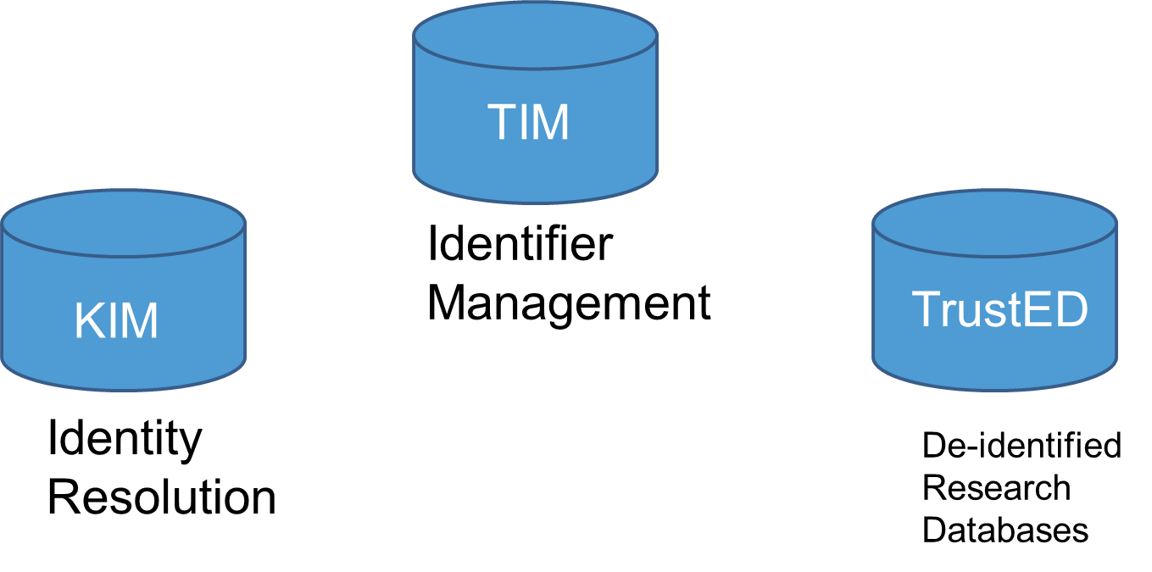
Arkansas
TrustEd:
Knowledgebase Identity Management (KIM) TrustEd Identifier Management (TIM)

Slide 34

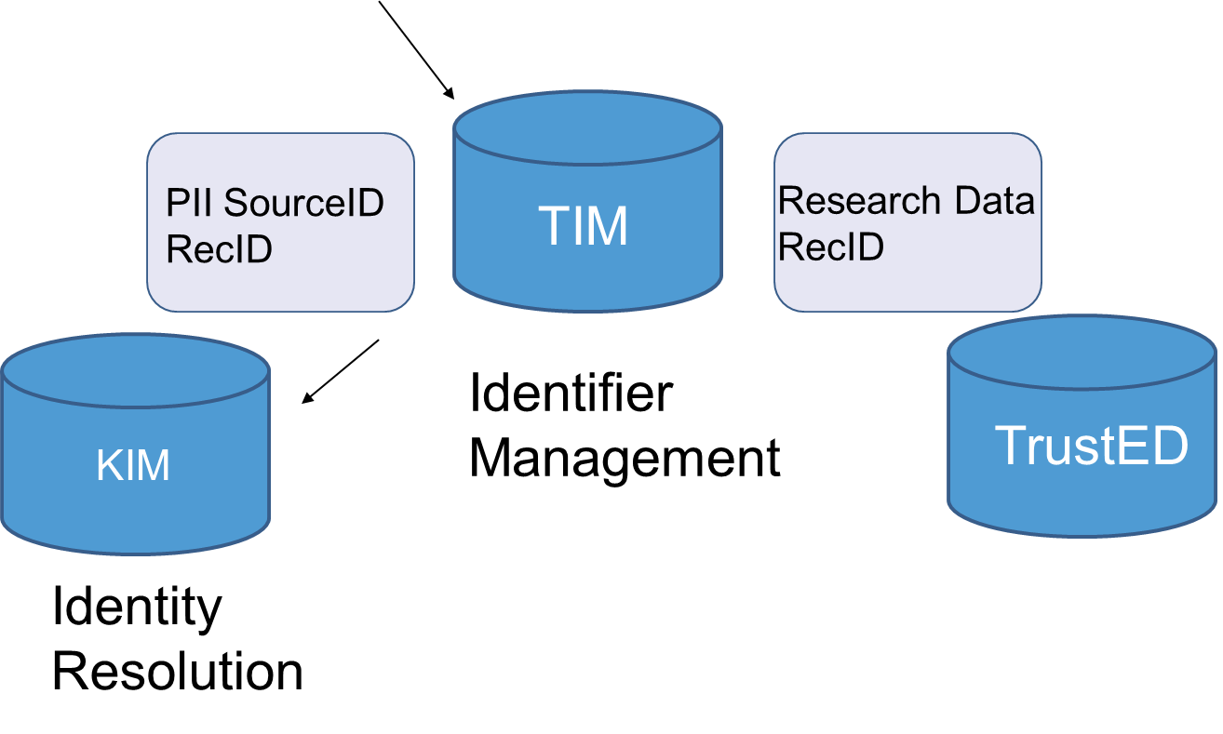
Arkansas
TrustEd: KIM & TIM

Slide 35
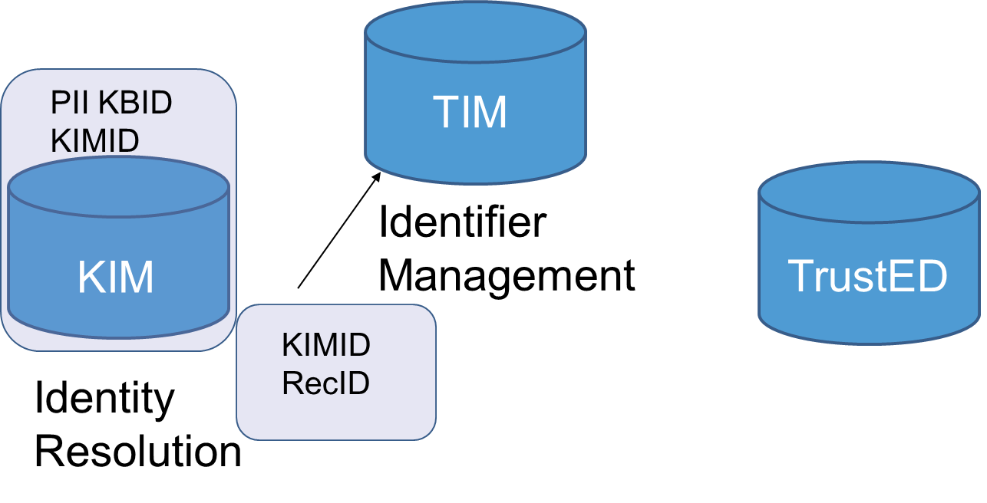
Arkansas
TrustEd: KIM & TIM

Slide 36
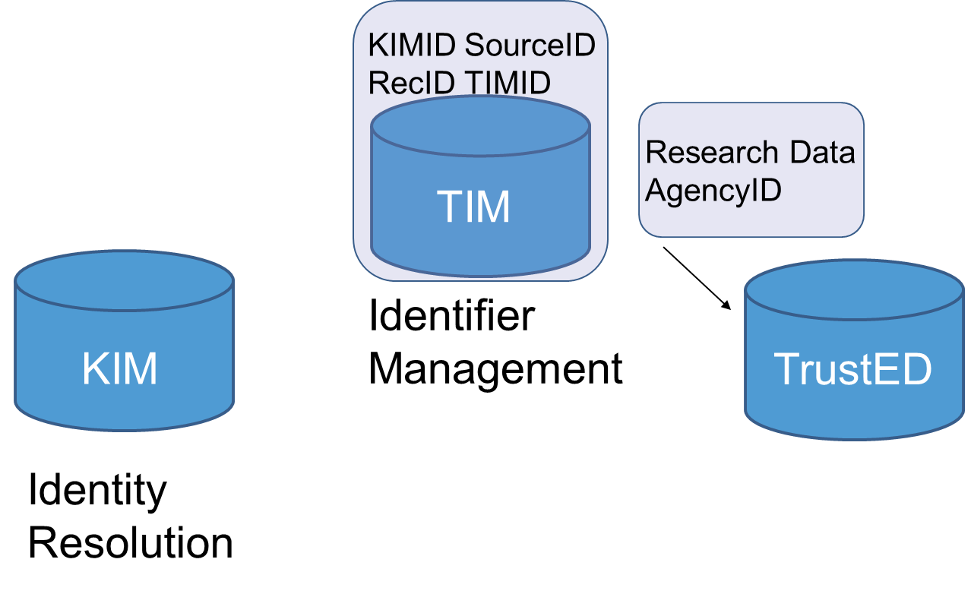
Arkansas

Slide 37
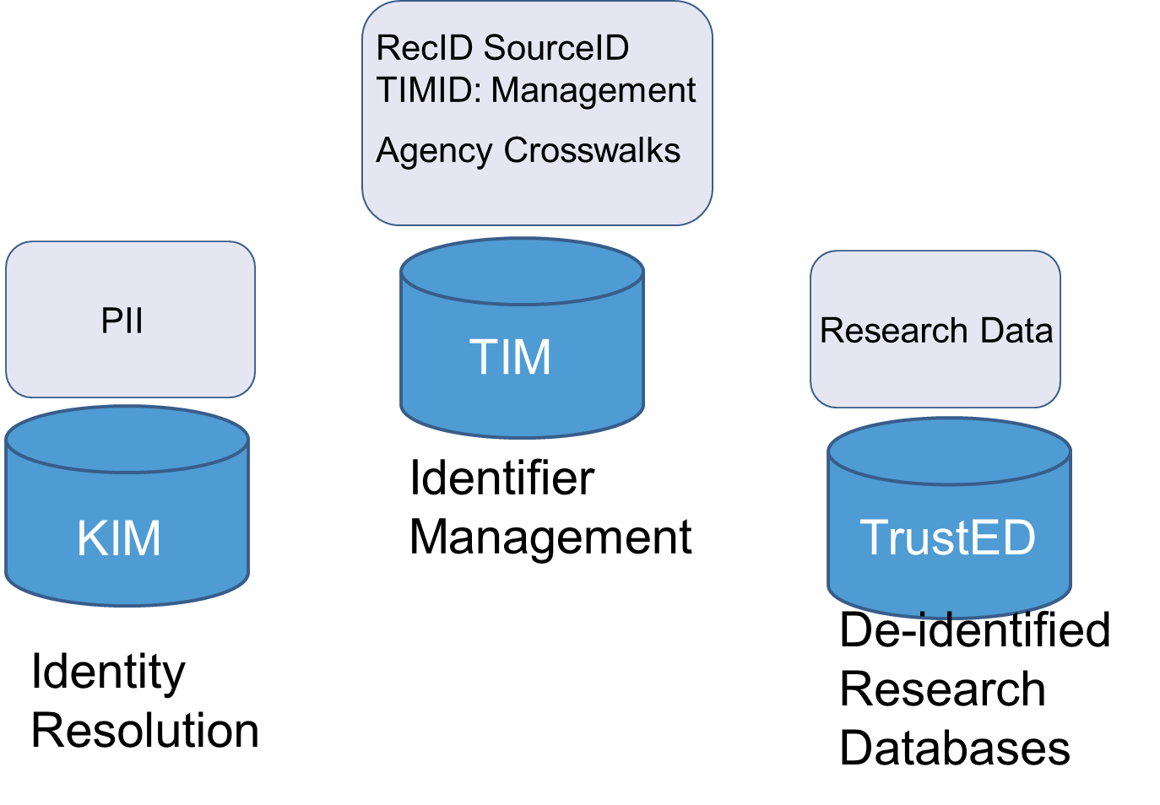
Arkansas

Slide 38
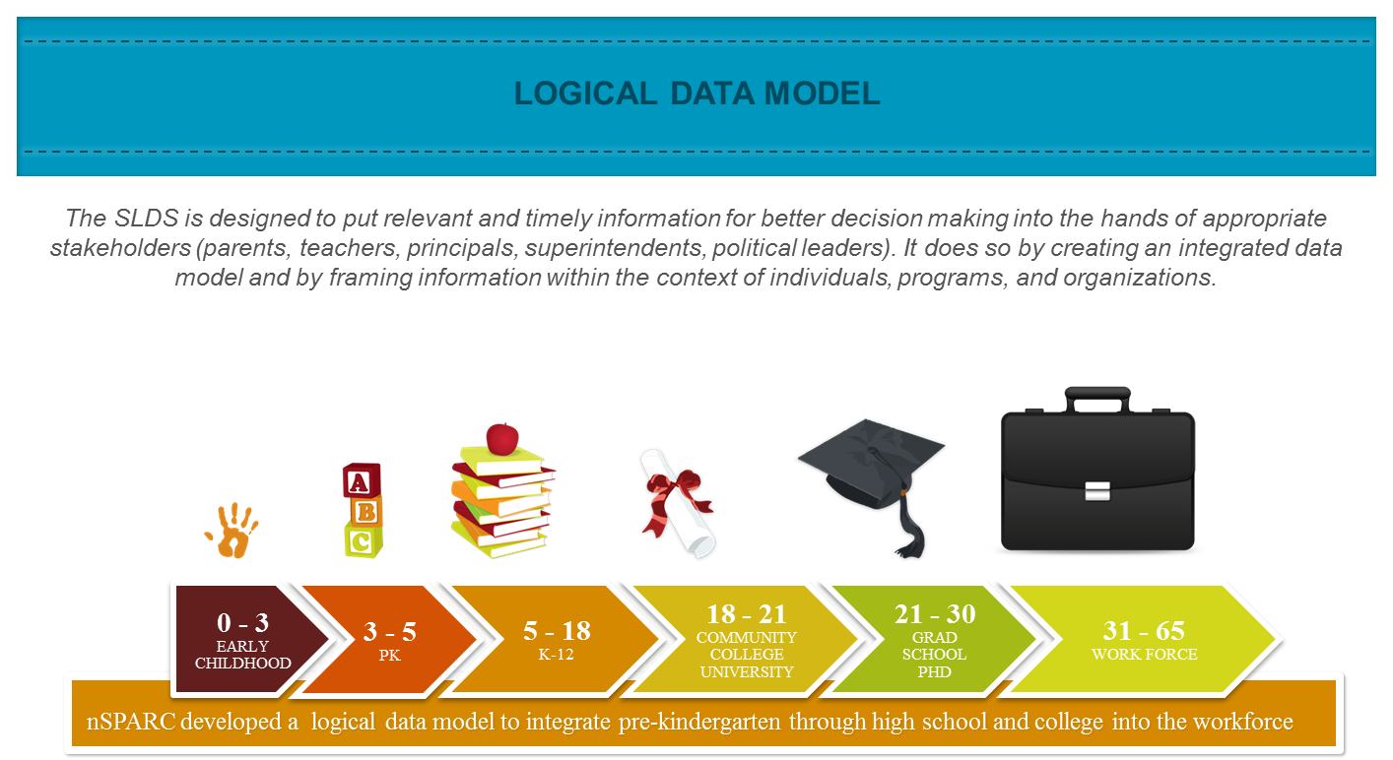
Mississippi

Slide 39


Mississippi
has
0..n
Individual
has
has
has
0..1
1..n
Organization
Program
0..n
has
1..n

Slide 40
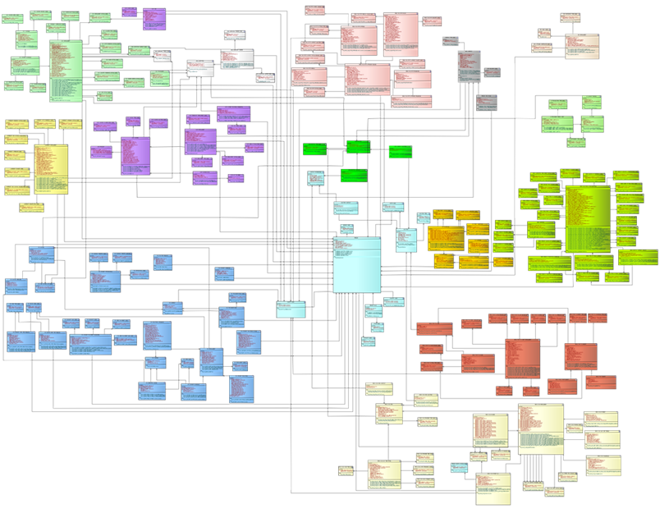
Mississippi
SLDS ENTITY RELATIONSHIP DIAGRAM

Slide 41

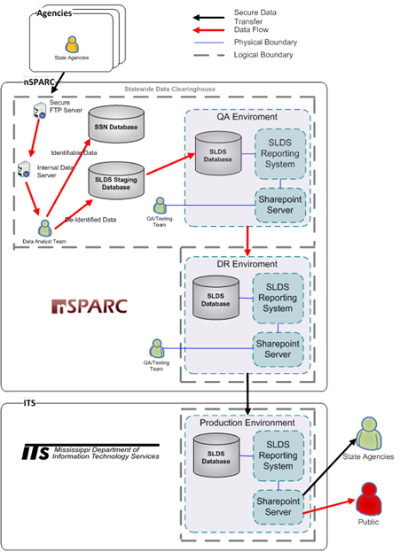
Mississippi

Slide 42

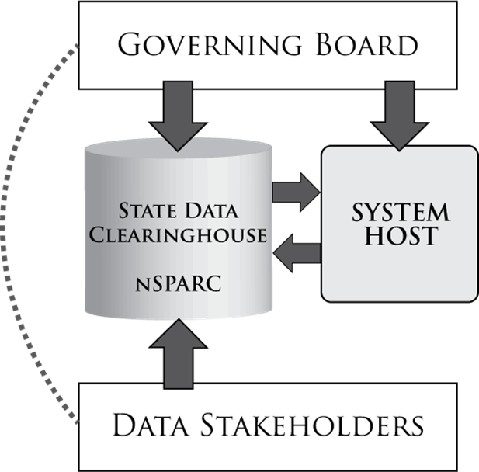
Mississippi

Slide 43
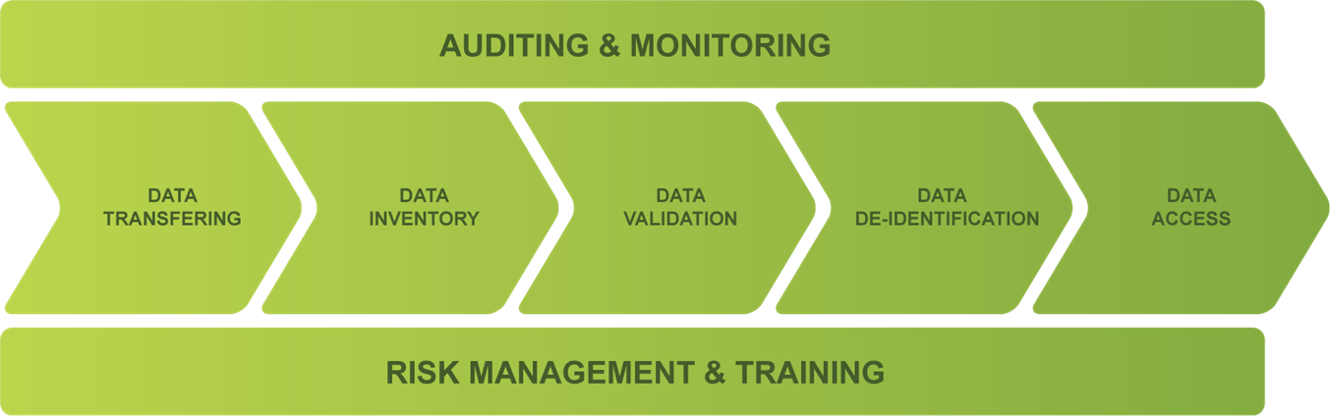
Mississippi
DATA LIFECYCLE

Slide 44
Data Access

Slide 45
Kentucky
Agencies have access to all the identifiable data they have provided to P-20 – but not to each other’s.
Agencies and P-20 Staff have access to the de-identified production data. Shared “universes” go live in December.
P-20 Staff respond to multi-agency data requests with vetting process to validate for accuracy.
Access through Business Objects Web Intelligence (WebI), P-20 staff use WebI, Crystal, SSRS, SPSS, SAS, Arc-View, and other tools.
Data retention as needed. Long-term retention to be determined.

Slide 46

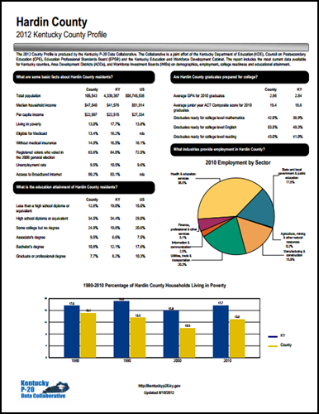
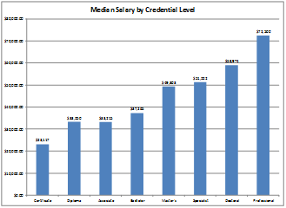
Kentucky
Centralized Reporting for Cross-Agency Issues
High School Feedback
Adult Education Feedback
Employment Outcomes and Earnings
County Profiles
Workforce and Training Outcomes

Slide 47
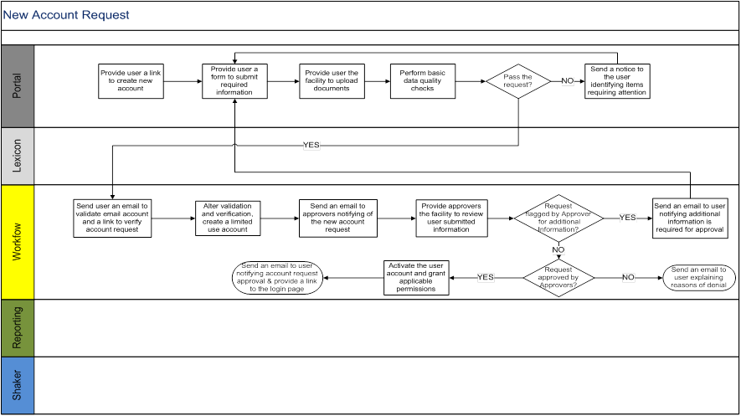
Virginia

Slide 48
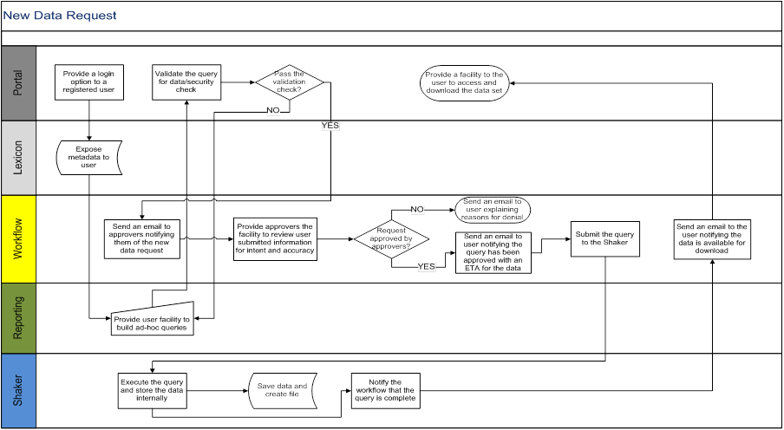
Virginia

Slide 49
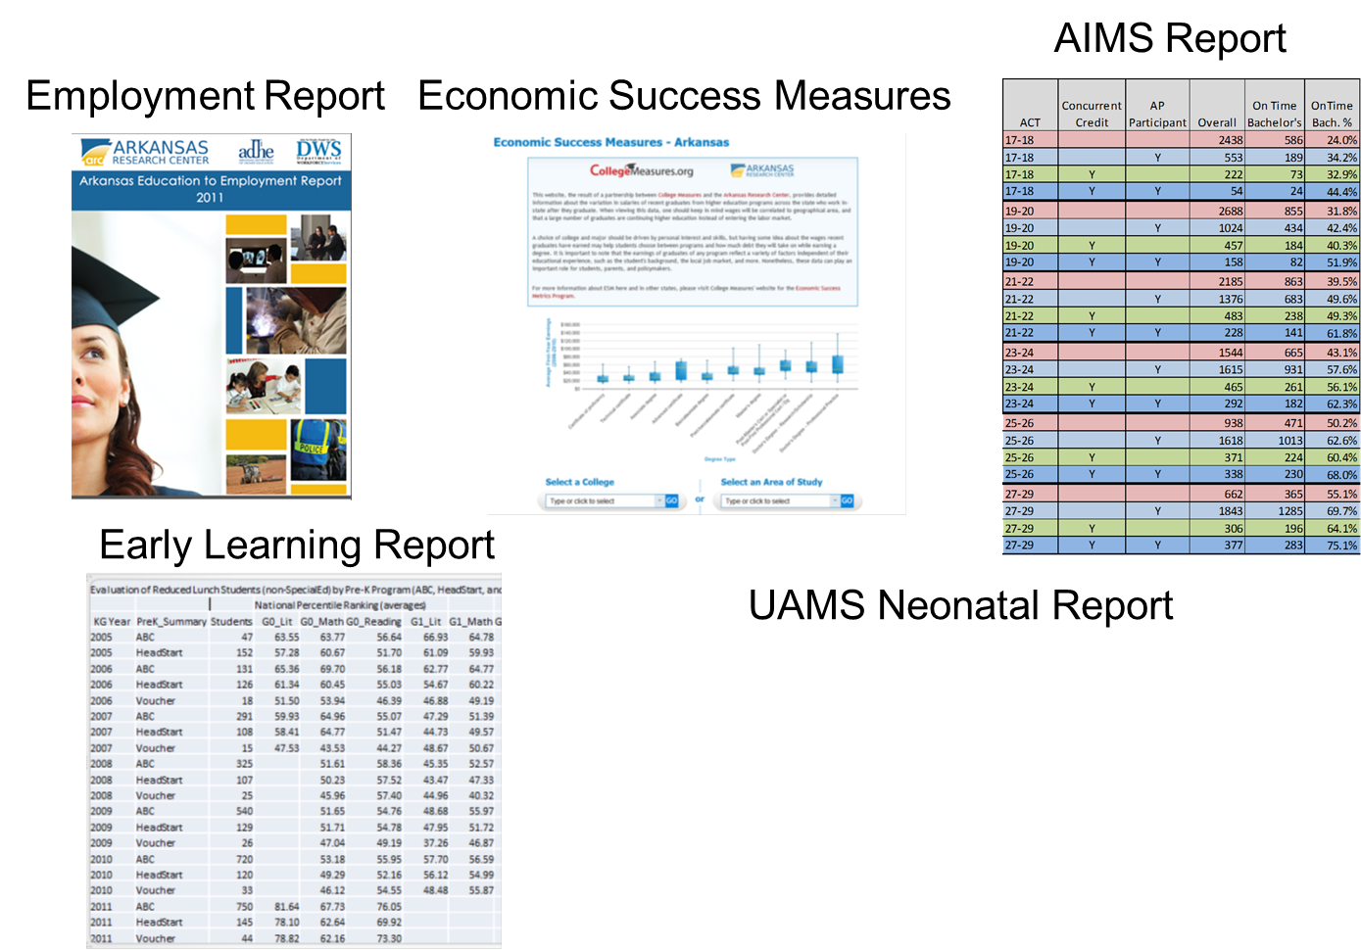
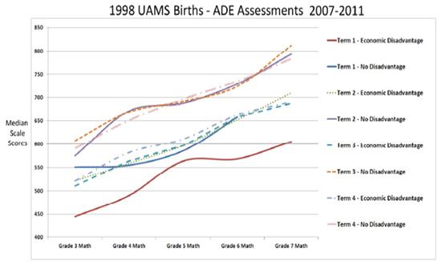
Arkansas
TrustEd: KIM & TIM

Slide 50

Mississippi
DATA ACCESS

Slide 51
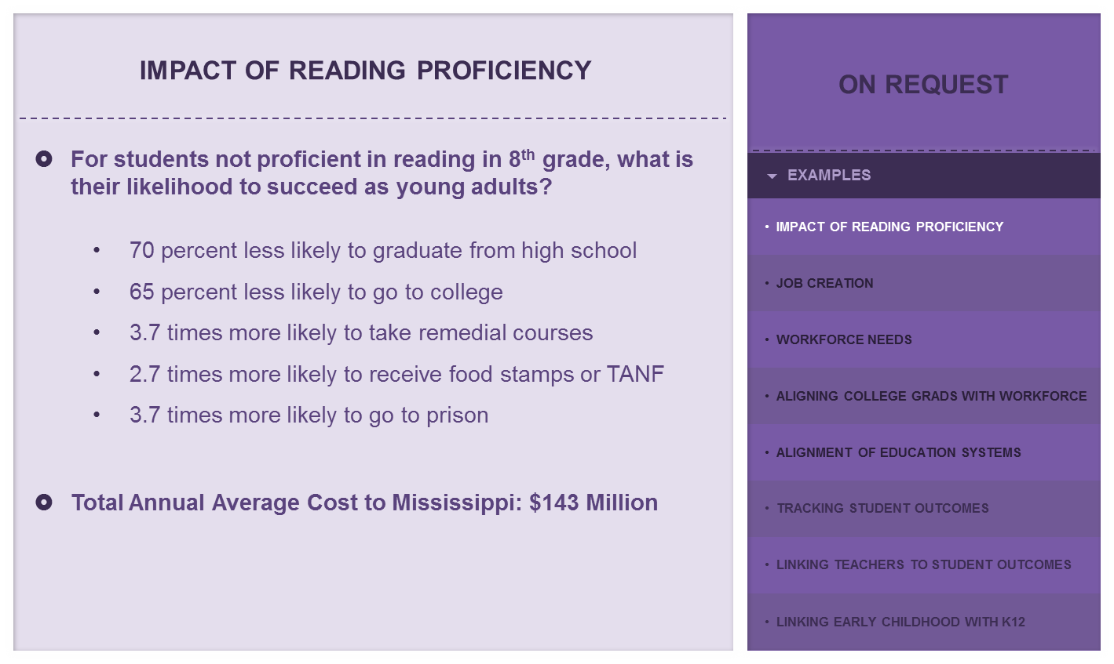
Mississippi

Slide 52
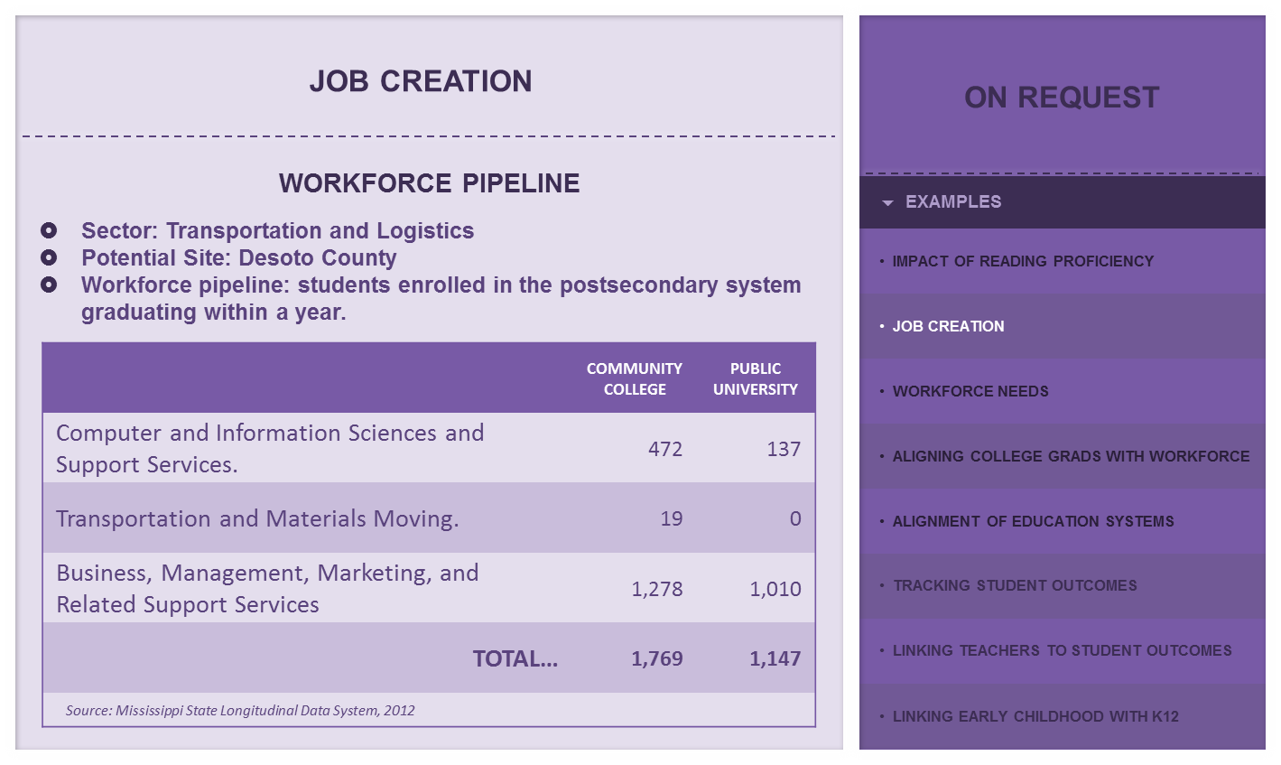
Mississippi

Slide 53
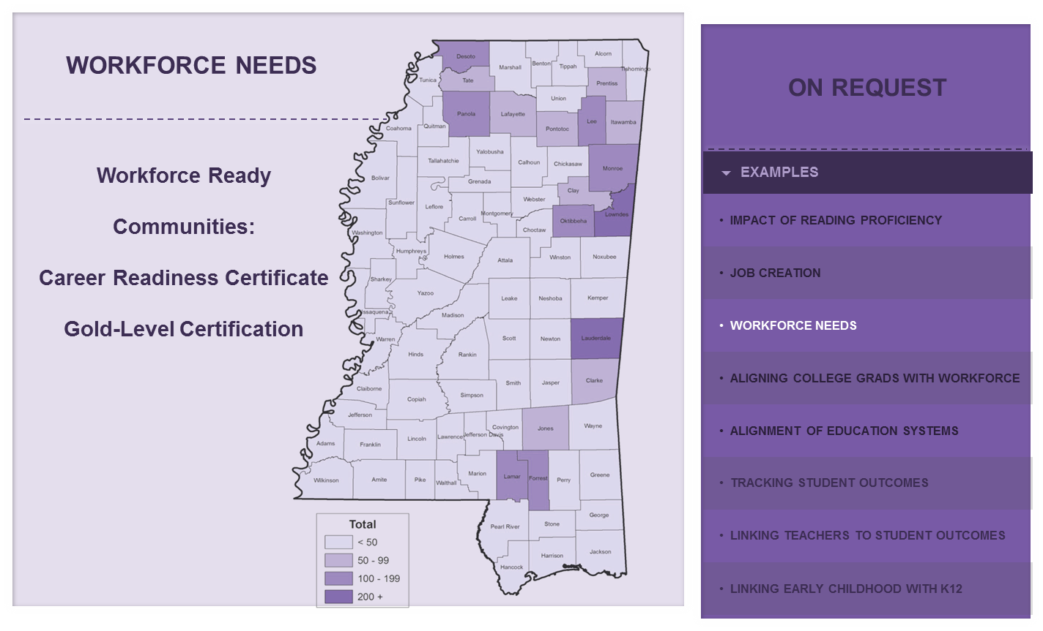
Mississippi

Slide 54

Mississippi

Slide 55

Mississippi

Slide 56
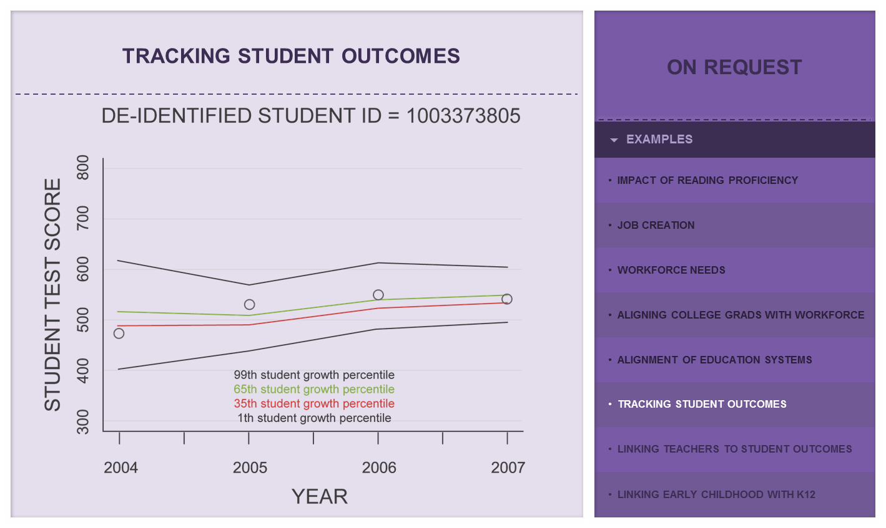
Mississippi

Slide 57
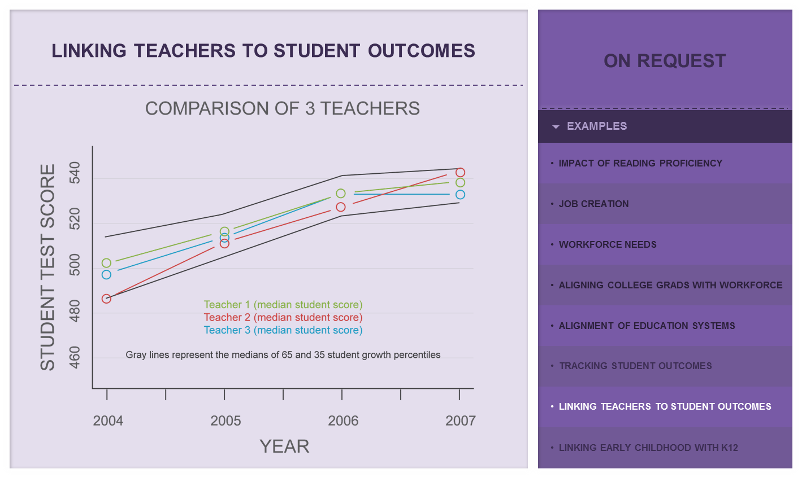
Mississippi

Slide 58
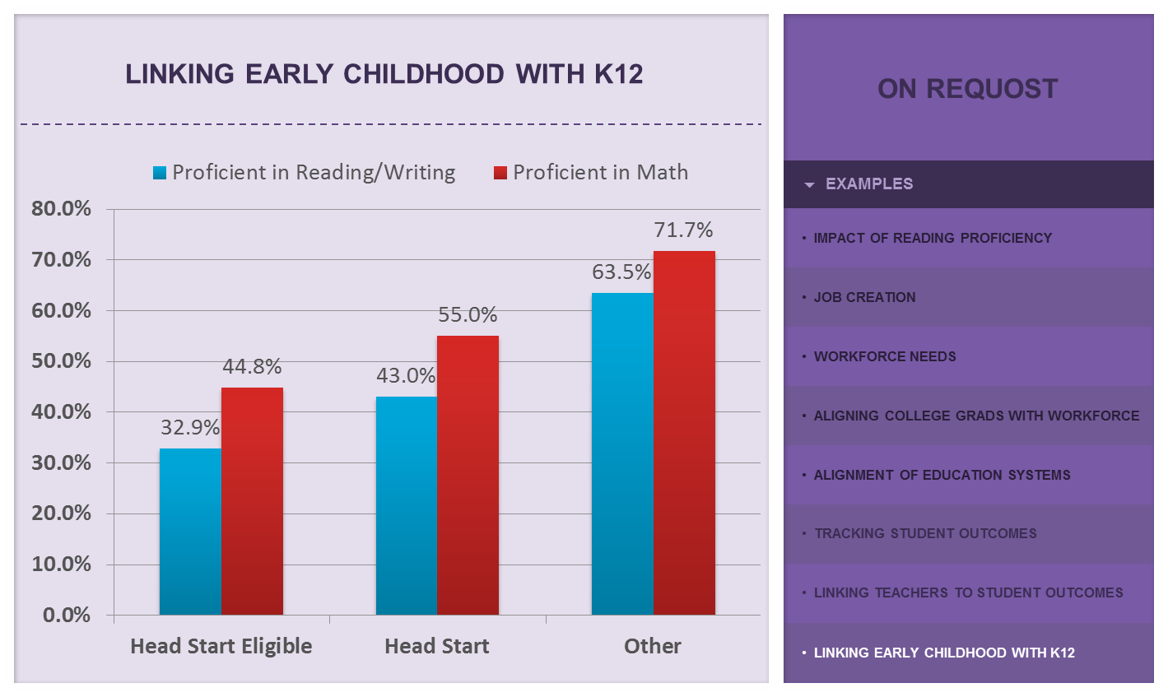
Mississippi

Slide 59
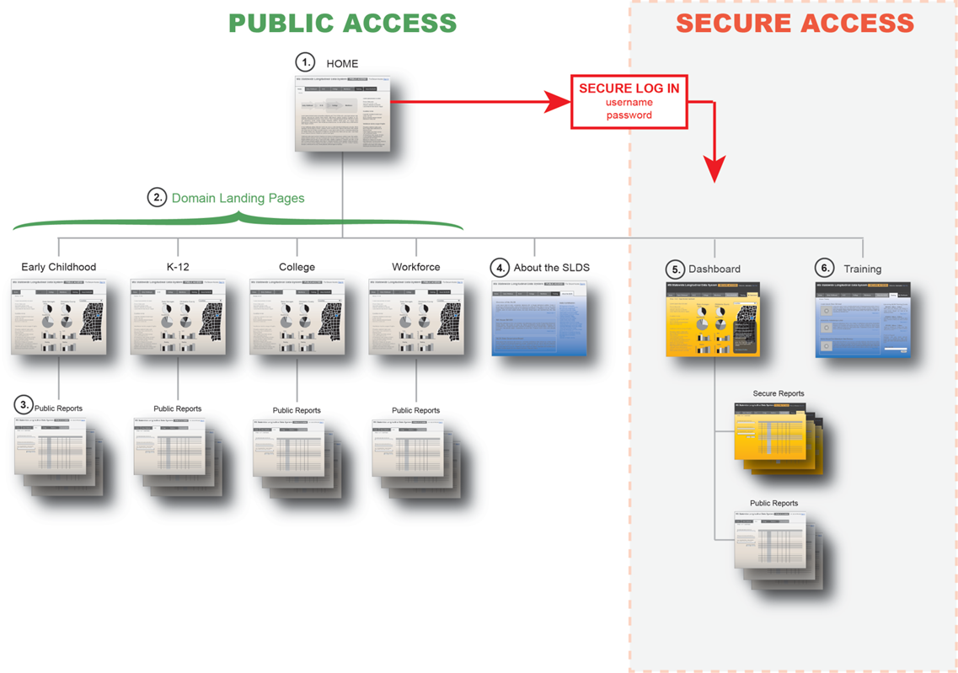
Mississippi

Slide 60
Contacts & Additional Resources
Contact information:
Charles McGrew, Charles.McGrew@ky.gov
Aaron Schroeder, aaron.schroeder@vt.edu
Neal Gibson, Neal.Gibson@arkansas.gov
Mimmo Parisi, MParisi@nsparc.msstate.edu
Jim Campbell, jim.campbell@sst-slds.org
Jeff Sellers, jeff.sellers@sst-slds.org
Keith Brown, keith.brown@sst-slds.org
Resources:
http://nces.ed.gov/programs/slds/pdf/federated_centralized_print.pdf

